Slide 1
Chapter 1. Basic Structure of Computers

Slide 2
Basic Operational Concepts

Slide 3
Review
Activity in a computer is governed by instructions.
To perform a task, an appropriate program consisting of a list of instructions is stored in the memory.
Individual instructions are brought from the memory into the processor, which executes the specified operations.
Data to be used as operands are also stored in the memory.

Slide 4
A Typical Instruction
Add LOCA, R0
Add the operand at memory location LOCA to the operand in a register R0 in the processor.
Place the sum into register R0.
The original contents of LOCA are preserved.
The original contents of R0 is overwritten.
Instruction is fetched from the memory into the processor – the operand at LOCA is fetched and added to the contents of R0 – the resulting sum is stored in register R0.

Slide 5
Separate Memory Access and ALU Operation
Load LOCA, R1
Add R1, R0
Whose contents will be overwritten?

Slide 6
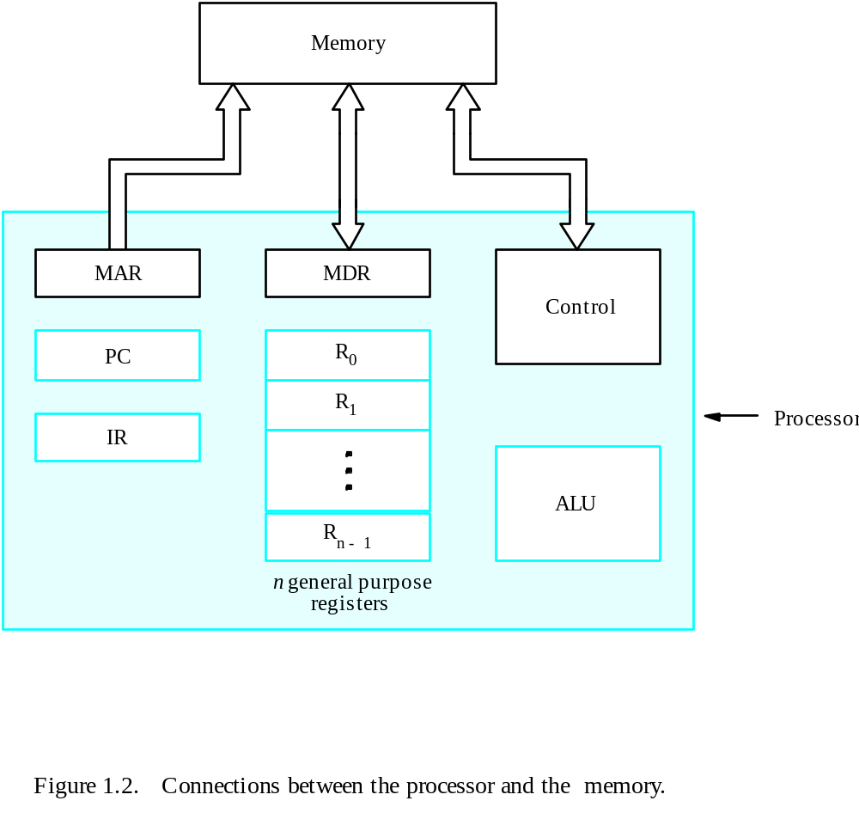
Connection Between the Processor and the Memory

Slide 7
Registers
Instruction register (IR)
Program counter (PC)
General-purpose register (R₀ – R_{n-1})
Memory address register (MAR)
Memory data register (MDR)

Slide 8
Typical Operating Steps
Programs reside in the memory through input devices
PC is set to point to the first instruction
The contents of PC are transferred to MAR
A Read signal is sent to the memory
The first instruction is read out and loaded into MDR
The contents of MDR are transferred to IR
Decode and execute the instruction

Slide 9
Typical Operating Steps (Cont’)
Get operands for ALU
  General-purpose register
  Memory (address to MAR – Read – MDR to ALU)
Perform operation in ALU
Store the result back
  To general-purpose register
  To memory (address to MAR, result to MDR – Write)
During the execution, PC is incremented to the next instruction

Slide 10
Interrupt
Normal execution of programs may be preempted if some device requires urgent servicing.
The normal execution of the current program must be interrupted – the device raises an interrupt signal.
Interrupt-service routine
Current system information backup and restore (PC, general-purpose registers, control information, specific information)

Slide 11
Interrupt
An interrupt is a request from an I/O device for service by the processor
In order to deal with the request, the normal execution is interrupted and the device raises the interrupt signal.
ISR (Interrupt Service Routine)
The processor provides the requested service by executing an ISR.
ISR saves the internal state of the processor, PC, the general registers and some control information.
When ISR is completed the state of the processor is restored and interrupted program may continue its execution.

Slide 12
Bus Structures
There are many ways to connect different parts inside a computer together.
A group of lines that serves as a connecting path for several devices is called a bus.
Address/data/control

Slide 13
Bus Structures
A group of lines that serve as a connecting path for several devices is called a bus.
The system bus has three parts:
  Data bus
  Address bus
  Control bus
There are two types of bus:
  Single bus structure
  Multi bus structure

Slide 14
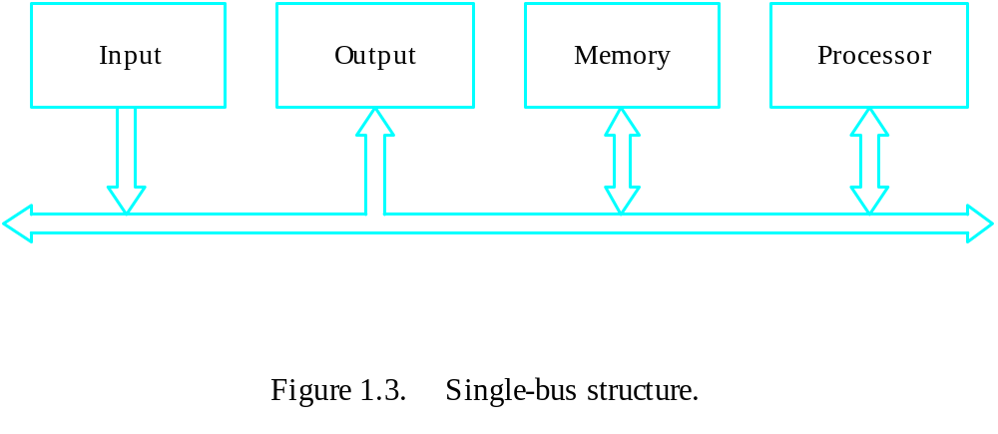
Single Bus Structure
All units are connected to a single bus.
Only two devices can connect at a time.
Single bus structure is vastly used because of its low cost and flexibility.
The device connected to the bus widely vary with their speed of operation.
Include a buffer register to improve the performance
Ex: Consider the transfer of an encoded character from the processor to the printer.
Fig: single bus structure

Slide 15
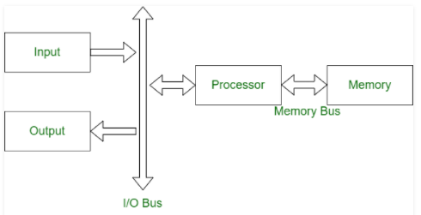
Drawback of Single Bus Structure:
  The performance of the computer system suffers when large number of device is connected to the bus.
  Propagation Delay
  Bus- Bottleneck
  Multiple Bus Structure:
    Achieve more concurrency
    Leads to better performance
    Increased cost
Fig: double bus structure

Slide 16
Speed Issue
Different devices have different transfer/operate speed.
If the speed of bus is bounded by the slowest device connected to it, the efficiency will be very low.
How to solve this?
A common approach – use buffers.

Slide 17
Exercise Problems
List the steps needed to execute the machine instruction
ADD LOCA,R0
Assume that instruction is stored in the memory and address is initially in register PC. Remember to include the steps needed to update the contents of PC so that the next instruction can be fetched.
2. List the steps needed to execute the machine instruction
ADD R1,R2,R3
Assume that instruction is stored in the memory and address is initially in register PC. Remember to include the steps needed to update the contents of PC so that the next instruction can be fetched.

Slide 18
Solution(problem 1)
Transfer the contents of register PC to register MAR , issue a read signal and then wait until it has transferred the requested word into register MDR
Transfer the instruction from MDR into IR and decode it
Transfer the address LOCA from IR to MAR ,issue a Read signal and wait until MDR is loaded
Transfer contents of MDR to the ALU
Transfer contents of R0 to the ALU
Perform addition of the two operands in the ALU and transfer result into R0
Update PC

Slide 19
Solution(problem2):
Transfer the contents of register PC to register MAR , issue a read signal and then wait until it has transferred the requested word into register MDR
Transfer the instruction from MDR into IR and decode it
Transfer contents of R1 and R2 to the ALU
Perform addition of two operands in the ALU and transfer answer into R3
Update PC

Slide 20
Performance

Slide 21
Performance
Performance is the time taken by the system to execute a program.
The most important measure of a computer is how quickly it can execute programs.
Three factors affect performance:
Hardware design
Machine Instruction
Compiler
Elapsed time: The total time required to execute the program.
Processor Time: The period in which the processor is active.

Slide 22
Performance
Processor time to execute a program depends on the hardware involved in the execution of individual machine instructions.
Main
Cache
memory
memory
Processor
Bus
Figure 1.5.
The processor cache.

Slide 23
Performance
The processor and a relatively small cache memory can be fabricated on a single integrated circuit chip.
Speed
Cost
Memory management

Slide 24
Processor Clock
Timing signals-Clock
Timing Intervals- clock cycle
Cycles per sec(Hertz) R=1/p -clock rate
The execution of each instruction is divided into several steps, each of which completes in one clock cycle.
Hertz – cycles per second

Slide 25
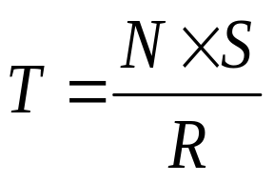
Basic Performance Equation
T – processor time required to execute a program that has been prepared in high-level language
N – number of actual machine language instructions needed to complete the execution (note: loop)
S – average number of basic steps needed to execute one machine instruction. Each step completes in one clock cycle
R – clock rate
Note: these are not independent to each other
How to improve T?

Slide 26
Clock Rate
There are two possibilities of increasing the clock rate R,
Increase clock rate
Improve the integrated-circuit (IC) technology to make the circuits faster
Reduce the amount of processing done in one basic step (however, this may increase the number of basic steps needed)
Increases in R that are entirely caused by improvements in IC technology affect all aspects of the processor’s operation equally except the time to access the main memory.

Slide 27
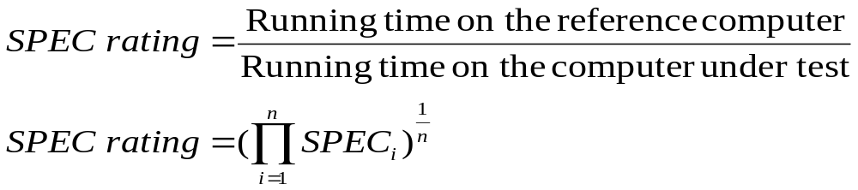
Performance Measurement
T is difficult to compute.
Measure computer performance using benchmark programs.
System Performance Evaluation Corporation (SPEC) selects and publishes representative application programs for different application domains, together with test results for many commercially available computers.
Compile and run (no simulation)
Reference computer

Slide 28
Chapter 2. Machine Instructions and Programs

Slide 29
Memory Locations, Addresses, and Operations

Slide 30
Memory Location, Addresses, and Operation
n
bits
Memory consists of many millions of storage cells, each of which can store 1 bit.
Data is usually accessed in n-bit groups. n is called word length.
first word
second word
•
•
•
i
th word
•
•
•
last word
Figure 2.5. Memory words.

Slide 31
Memory Location, Addresses, and Operation
32-bit word length example
32 bits
•
•
•
b
31
b
30
b
1
b
0
Sign bit:
b
31
=
0
for positive numbers
b
31
=
1
for negative numbers
(a) A signed integer
8 bits
8 bits
8 bits
8 bits
ASCII
ASCII
ASCII
ASCII
character
character
character
character
(b) Four characters

Slide 32
Memory Location, Addresses, and Operation
To retrieve information from memory, either for one word or one byte (8-bit), addresses for each location are needed.
A k-bit address memory has 2^{k} memory locations, namely 0 – 2^{k}-1, called memory space.
24-bit memory: 2²⁴ = 16,777,216 = 16M (1M=2²⁰)
32-bit memory: 2³² = 4G (1G=2³⁰)
1K(kilo)=2¹⁰
1T(tera)=2⁴⁰

Slide 33
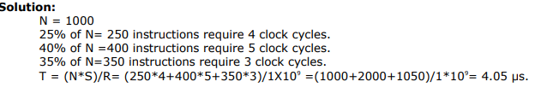
Problems
A program contains 1000 instructions. Out of that 25% instructions requires 4 clock cycles,40% instructions requires 5 clock cycles and remaining require 3 clock cycles for execution. Find the total time required to execute the program running in a 1 GHz machine.

Slide 34
Example2: For the following processor, obtain the performance. Clock rate = 800 MHz No. of instructions executed = 1000 Average no of steps needed / machine instruction = 20.
Solution:
T = N * S / R

Slide 35
Example 3:
The Effective value of S is 1.25 and the average value of N is 200. if the clock rate is 500MHz , calculate the total program execution time required.

Slide 36
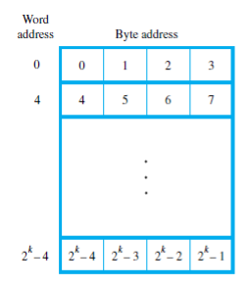
Byte Addressability
The are 3 basic information quantities ,
bit
byte and
word.
The word length typically ranges from 16 to 64 bits.
The most practical assignment is to have successive addresses refer to successive byte locations in the memory.
The term byte addressable memory is used for this assignment.
Byte locations have addresses 0,1,2,3,…….
If the word length of machine is 32 bits , successive words are located at addresses 0,4,8,…., with each word consisting of four bytes.

Slide 37
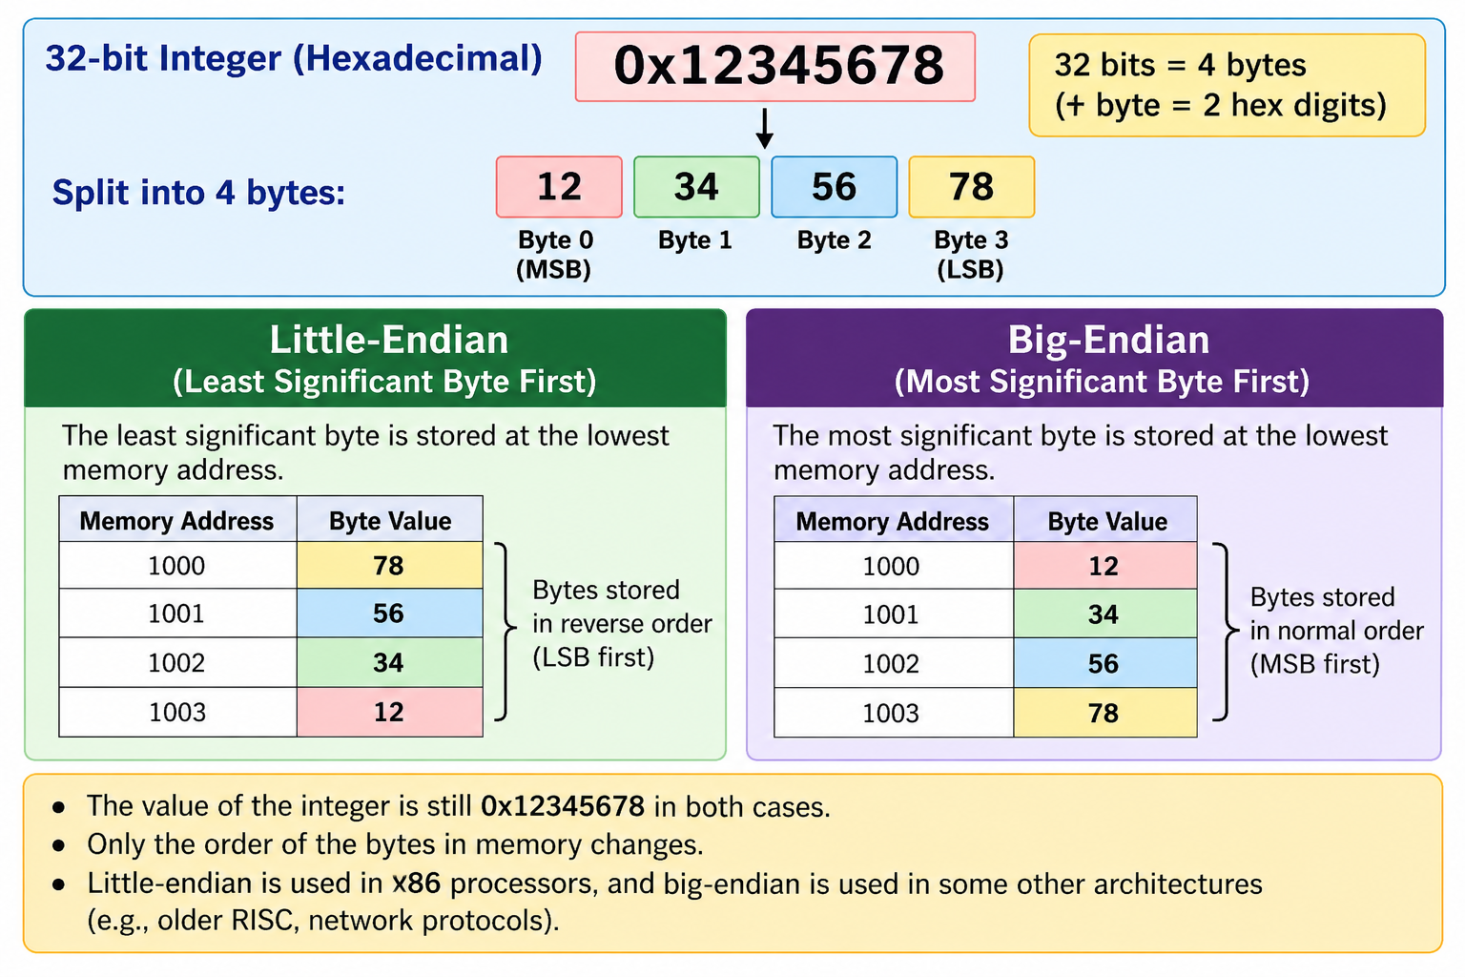

Slide 38
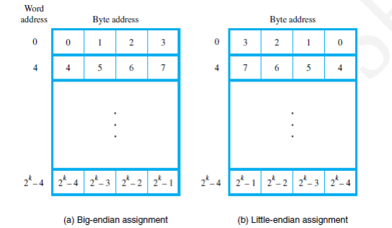
Big- Endian and Little – Endian Assignments
There are 2 ways that byte addresses can be assigned across words.
Big-Endian : Lower byte addresses are used for the most significant bytes of words.
Little–Endian : Lower byte addresses are used for the least significant bytes of words.

Slide 39
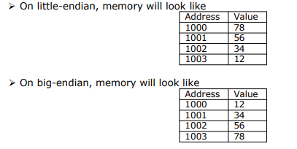
Consider a 32-bit integer (in hex): 0x12345678 which consists of 4 bytes: 12, 34, 56, and78.
Hence this integer will occupy 4 bytes in memory.
Assume, we store it at memory address starting 1000.

Slide 40
Word alignment
Words are said to be Aligned in memory if they begin at a byte-address that is a multiple of the number of bytes in a word
For example,
If the word length is 16(2 bytes), aligned words begin at byte-addresses 0, 2, 4 . . . . .
If the word length is 64(8 bytes), aligned words begin at byte-addresses 0, 8, 16 . . . . .
Words are said to have Unaligned Addresses, if they begin at an arbitrary byte-address.

Slide 41
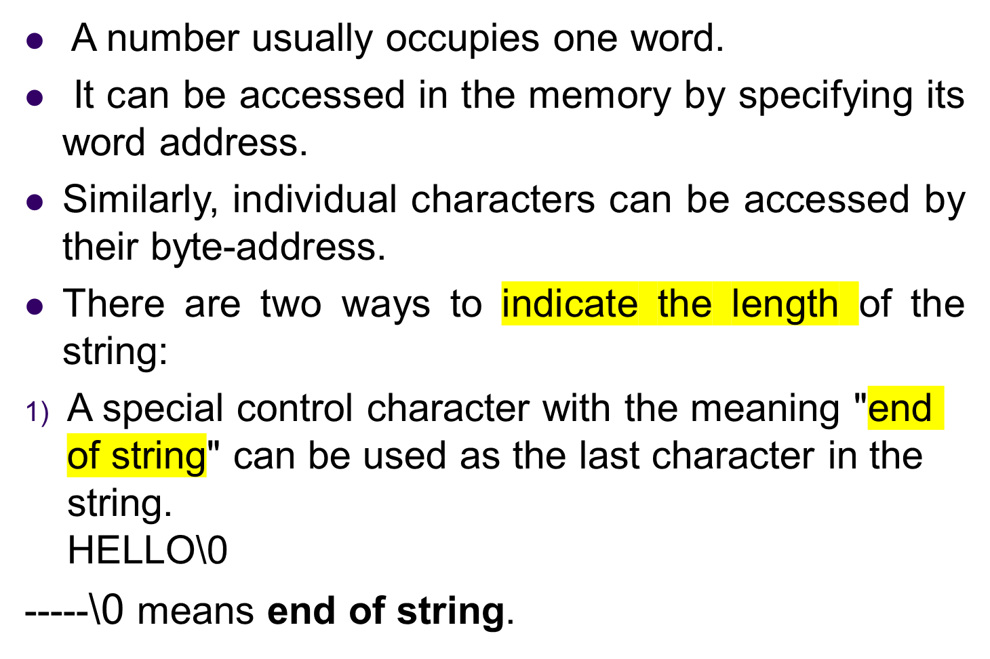
ACCESSING NUMBERS, CHARACTERS & CHARACTERS STRINGS

Slide 42
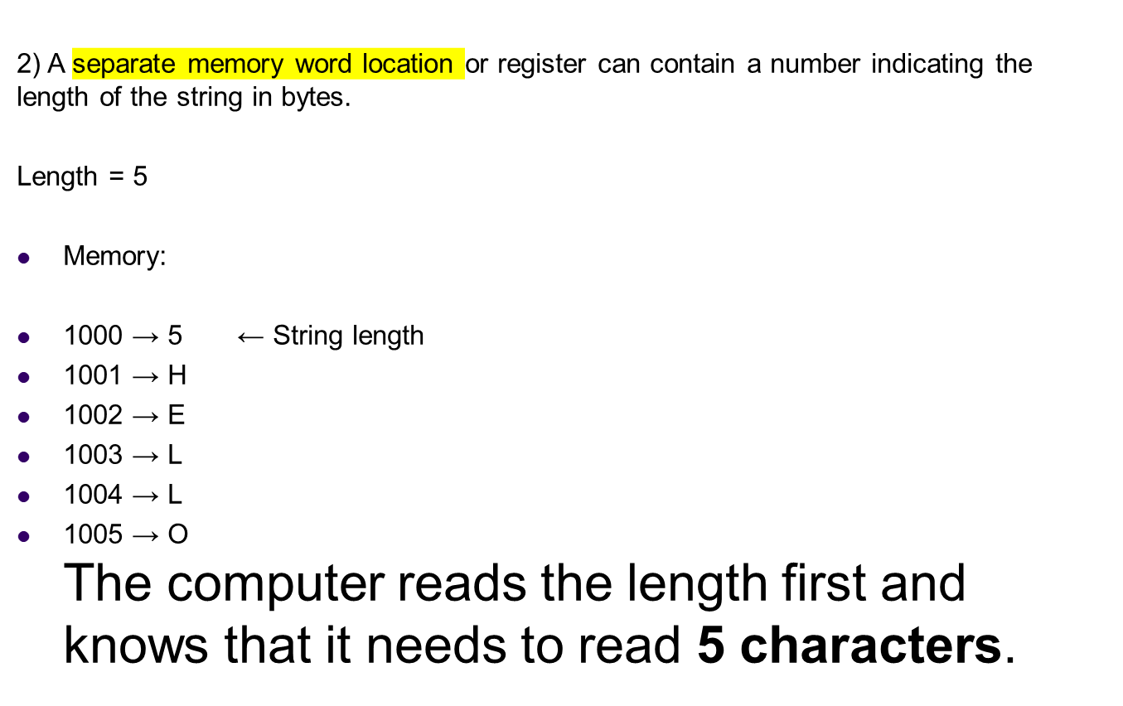

Slide 43
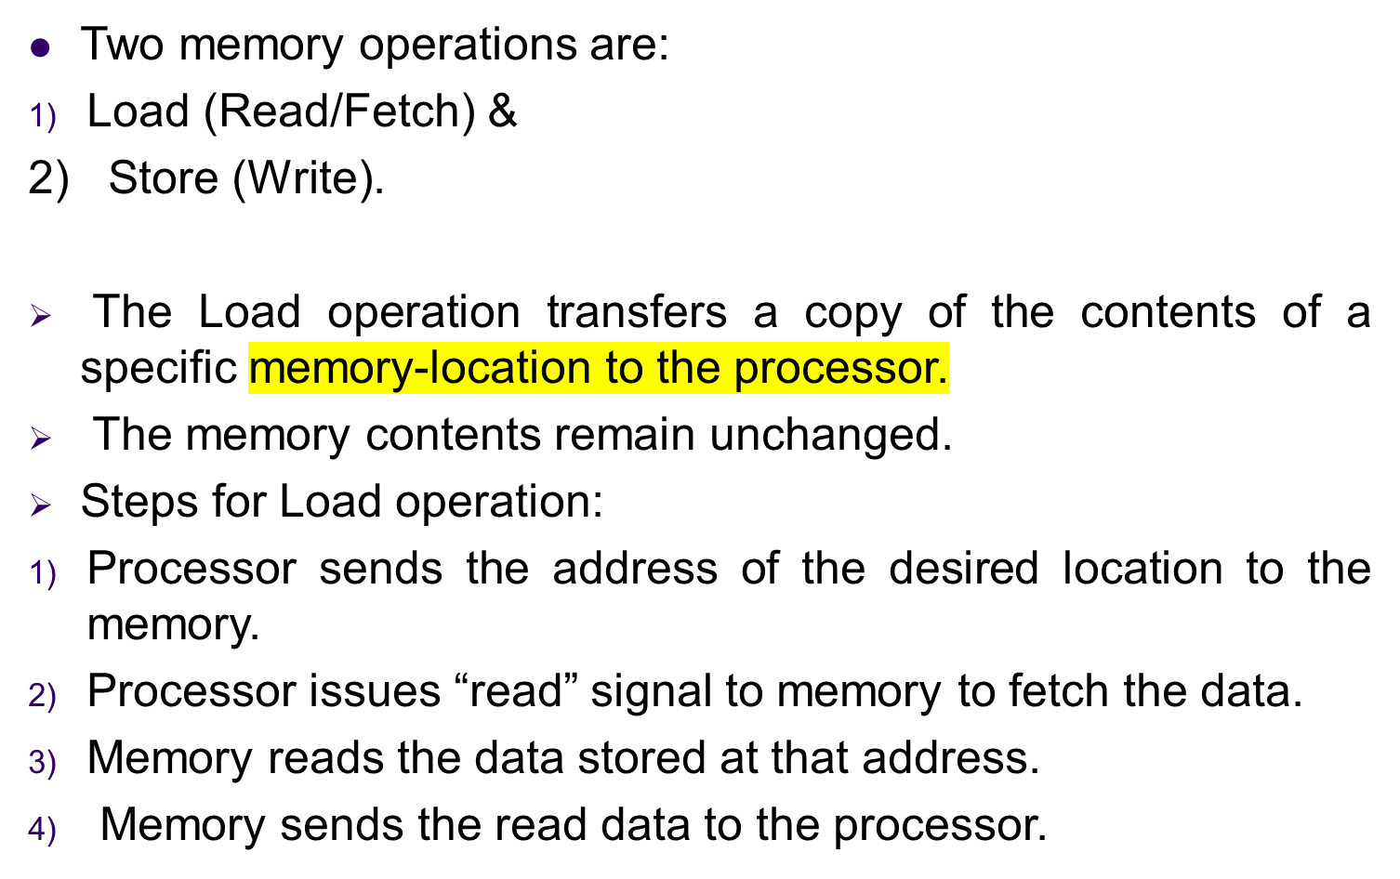
Memory Operations

Slide 44
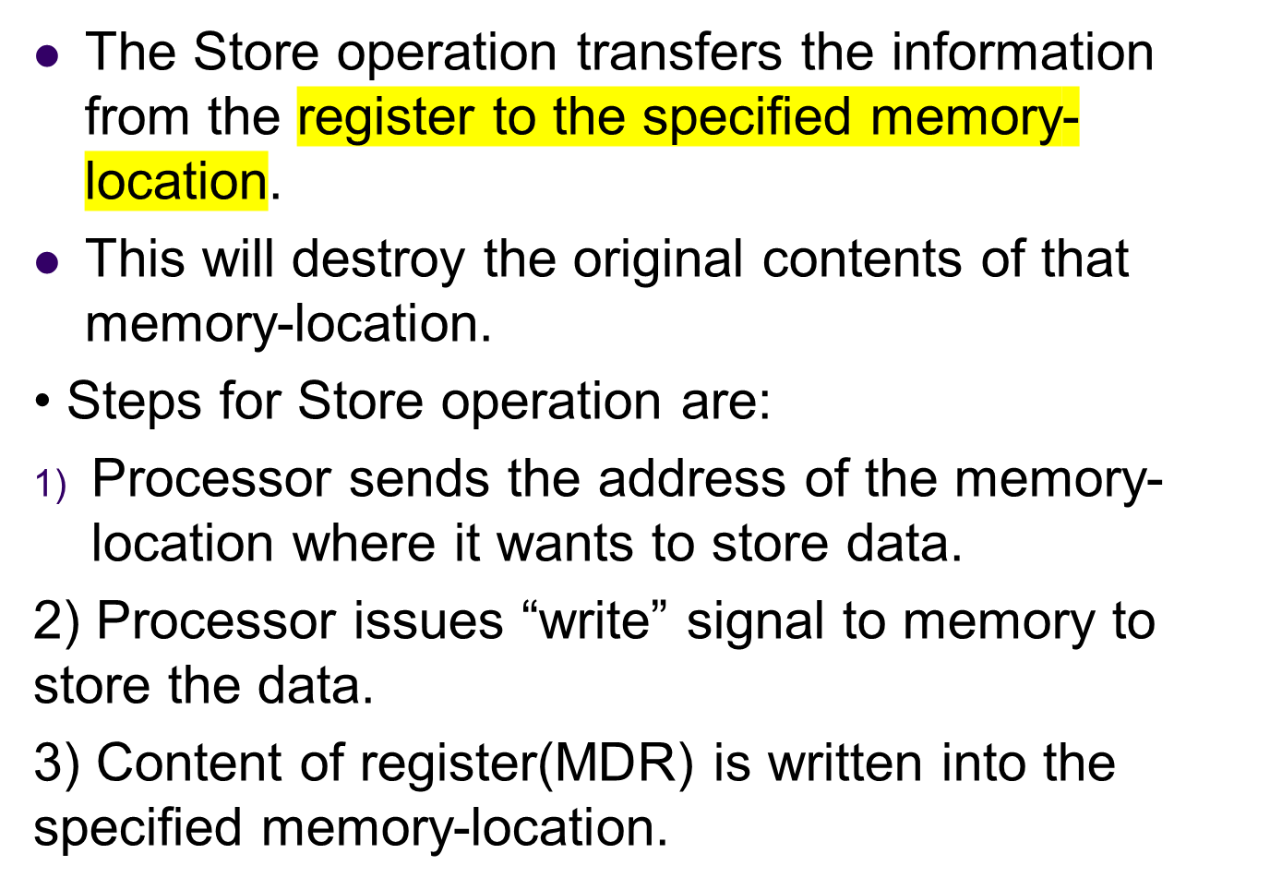

Slide 45
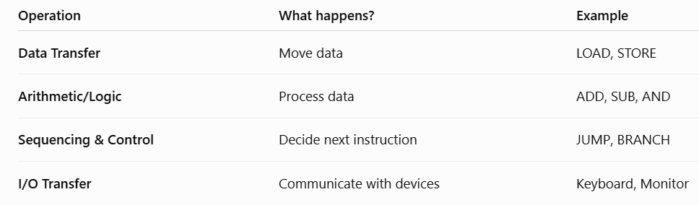
INSTRUCTIONS & INSTRUCTION SEQUENCING
A computer must have instructions capable of performing 4 types of operations:
Data transfers between the memory and the registers
Arithmetic and logic operations on data
3) Program sequencing and control
4) I/0 transfers.

Slide 46
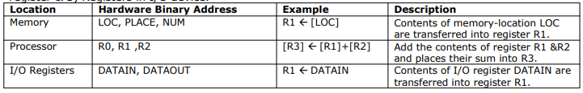
Register Transfer Notation
The possible locations in which transfer of information occurs are:
Memory locations
2) Processor registers &
3) Registers in I/O device.

Slide 47

ASSEMBLY LANGUAGE NOTATION
To represent machine instructions and programs, assembly language format is used.

Slide 48
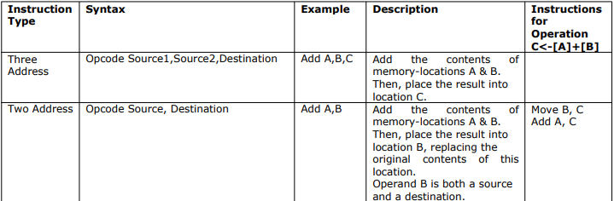
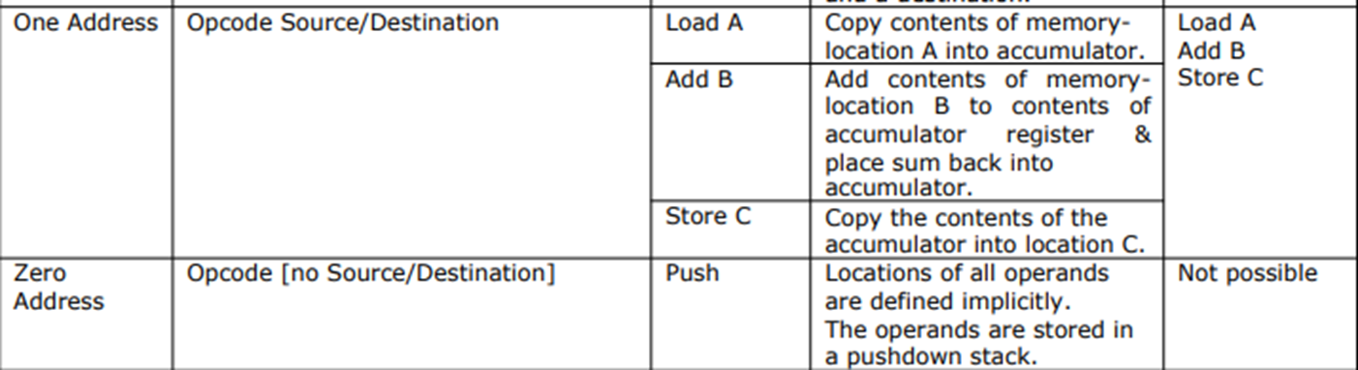
Basic Instruction Types:Ex C=A+B

Slide 49
Instruction Formats
Example: Evaluate (A+B) ∗ (C+D)
Three-Address
ADD A, B, T1
ADD C, D, T2
MUL T1, T2, X

Slide 50
Instruction Formats
Example: Evaluate (A+B) ∗ (C+D)
Two-Address
MOV T1, A
ADD T1, B
MOV T2, C
ADD T2, D
MUL T1, T2
MOV X, T1

Slide 51
Instruction Formats
Example: Evaluate (A+B) ∗ (C+D)
One-Address
  LOAD A ; AC ← M[A]
  ADD B ; AC ← AC + M[B]
  STORE T ; M[T] ← AC
  LOAD C ; AC ← M[C]
  ADD D ; AC ← AC + M[D]
  MUL T ; AC ← AC ∗ M[T]
  STORE X ; M[X] ← AC

Slide 52
Instruction Formats
Example: Evaluate (A+B) ∗ (C+D)
Zero-Address
  PUSH A ; TOS ← A
  PUSH B ; TOS ← B
  ADD ; TOS ← (A + B)
  PUSH C ; TOS ← C
  PUSH D ; TOS ← D
  ADD ; TOS ← (C + D)
  MUL ; TOS ← (C+D)∗(A+B)
  POP X ; M[X] ← TOS

Slide 53
Instruction Formats
Example: Evaluate (A+B) ∗ (C+D)
RISC
  LOAD R1, A ; R1 ← M[A]
  LOAD R2, B ; R2 ← M[B]
  LOAD R3, C ; R3 ← M[C]
  LOAD R4, D ; R4 ← M[D]
  ADD R1, R1, R2 ; R1 ← R1 + R2
  ADD R3, R3, R4 ; R3 ← R3 + R4
  MUL R1, R1, R3 ; R1 ← R1 ∗ R3
  STORE X, R1 ; M[X] ← R1

Slide 54
Using Registers
Registers are faster
Shorter instructions
  The number of registers is smaller (e.g. 32 registers need 5 bits)
Potential speedup
Minimize the frequency with which data is moved back and forth between the memory and processor registers.

Slide 55
Instruction Execution and Straight-Line Sequencing
Address
Contents
Assumptions:
- One memory operand
per instruction
- 32-bit word length
- Memory is byte
addressable
- Full memory address
can be directly specified
in a single-word instruction
Begin execution here
i
Move
A,R0
3-instruction
i
+ 4
Add
B,R0
program
segment
i
+ 8
Move
R0,C
A
B
Data for
the program
Two-phase procedure
Instruction fetch
Instruction execute
C
Page 43
Figure 2.8. A program for C ← [Α] + [Β].

Slide 56
How the program is executed
The processor contains a register called the program counter (PC), which holds the address of the instruction to be executed next.
To begin executing a program, the address of its first instruction, placed into the PC.
The processor control circuits use the information in the PC to fetch and execute instructions, one at a time, in the order of increasing addresses. This is called straight-line sequencing.
During the execution of each instruction , the PC is incremented by 4 to point to the next instruction.
Thus , after the Move instruction at location i + 8 is executed, the PC contains the value i + 12
Executing a given instruction in 2 phase
Instruction fetch
Instruction execute

Slide 57
Branching
i
Move
NUM1,R0
i
+
4
Add
NUM2,R0
i
+
8
Add
NUM3,R0
•
•
•
i
+
4
n
-
4
Add
NUM
n
,R0
i
+
4
n
Move
R0,SUM
•
•
•
SUM
NUM1
NUM2
•
•
•
NUM
n
Figure 2.9. A straight-line program for adding n numbers.

Slide 58
Consider the task of adding a list of n numbers.
The addresses of memory locations containing the n numbers are symbolically given as NUM1, NUM2.,………NUMn, and
Separate Add instruction is used to add each number to the contents of register R0.
After all the numbers have been added, the result is placed in memory-location SUM.
Instead of using a long list of Add instruction , it is possible to place a single Add instruction in a program loop.

Slide 59
Branching
Move
N,R1
Clear
R0
LOOP
Determine address of
"Next" number and add
Program
"Next" number to R0
loop
Decrement
R1
Branch target
Branch>0
LOOP
Move
R0,SUM
Conditional branch
•
•
•
SUM
N
n
NUM1
Figure 2.10. Using a loop to add n numbers.
NUM2
•
•
•
NUM
n

Slide 60
The loop is a straight- line sequence of instructions executed as many times as needed.
It starts at location LOOP and ends at the instruction Branch > 0.
During each pass through this loop , the address of the next list entry is determined , and the entry is fetched and added to R0.

Slide 61
Condition Codes
Condition code flags
Condition code register / status register
N (negative)
Z (zero)
V (overflow)
C (carry)
Different instructions affect different flags

Slide 62
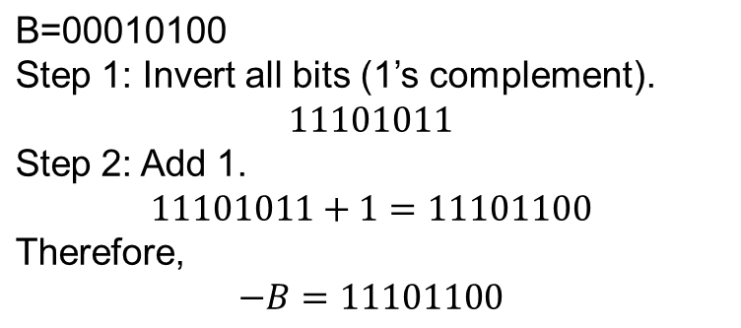
Conditional Branch Instructions
A: 1 1 1 1 0 0 0 0
Example:
  A: 1 1 1 1 0 0 0 0
  B: 0 0 0 1 0 1 0 0
+(−B): 1 1 1 0 1 1 0 0
1 1 0 1 1 0 0 0
C = 1
Z = 0
S = 1(Sign Flag)
V = 0

Slide 63
Addressing Modes

Slide 64
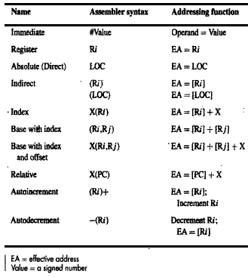
Addressing Modes
The different ways in which the location of the operand is specified in an instruction are referred to as addressing modes.

Slide 65
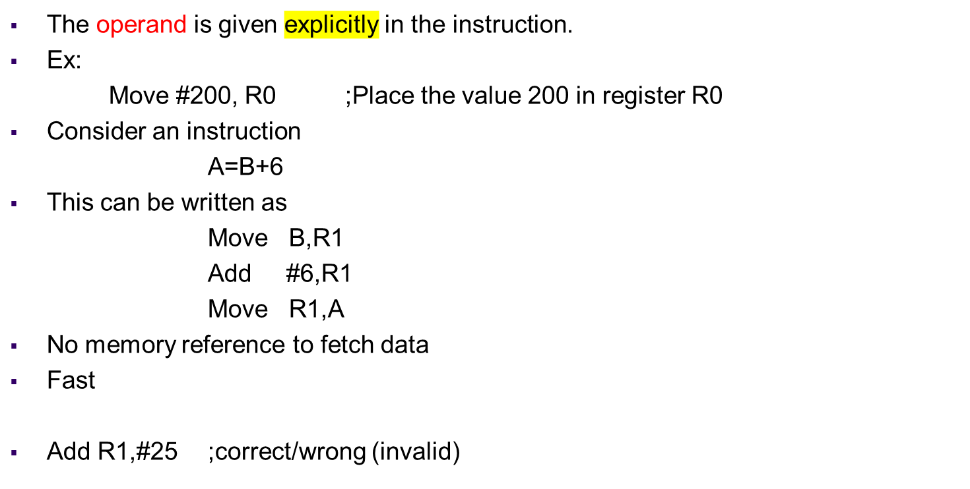
Immediate Mode

Slide 66
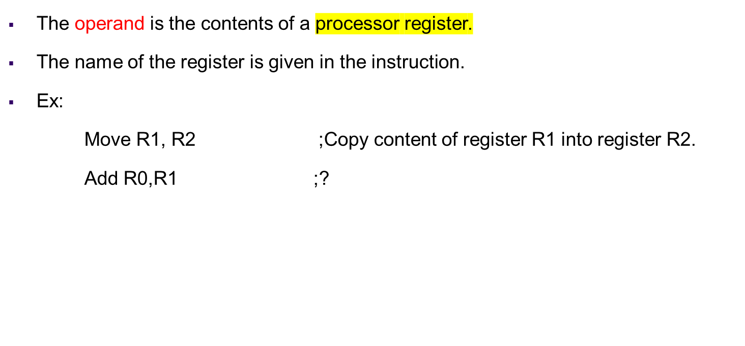
Register Mode

Slide 67

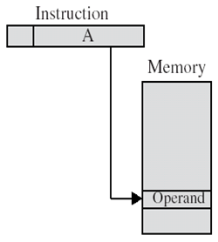
Absolute (Direct) Mode

Slide 68
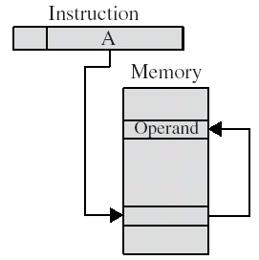
Indirect Mode
The effective address of the operand is the contents of a register or memory location whose address appears in the instruction
Effective Address=[Ri]
Effective Address=[LOC]
For ex:
Add (R1), R0
The register or memory-location that contains the address of an operand is called a Pointer

Slide 69
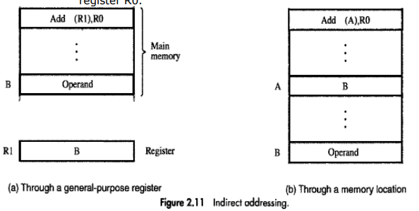
Indirect Addressing Modes

Slide 70
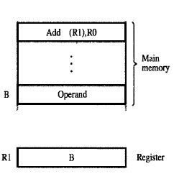
The processor uses the value which is in register R1, as the EA of the operand.
It requests a read operation from the memory to read the contents of location B.
The value read is the desired operand, which the processor adds to the contents of register R0.
Fig: Indirect Addressing through a general purpose resister

Slide 71
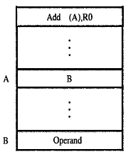
The processor first reads the contents of memory-location A
Then requests a second read operation using the value B as an address to obtain the operand.
Fig: Indirect Addressing through a memory location

Slide 72
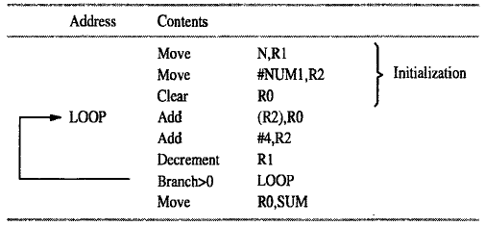
Register R2 is used as a pointer to the numbers in the list, and the operands are accessed indirectly through R2
The initialization-section of the program loads the counter-value n from memory-location N into R1 and uses the immediate addressing-mode to place the address value NUM1, which is the address of the first number in the list, into R2. Then it clears R0 to 0.
The first time through the loop, the instruction Add (R2), R0 fetches the operand at location NUM1 and adds it to R0.
The second Add instruction adds 4 to the contents of the pointer R2, so that it will contain the address value NUM2 when the above instruction is executed in the second pass through the loop.

Slide 73
Index mode
The effective address of the operand is generated by adding a constant value to the content of a register.
The register may be either a special register or any one register among the set of general purpose registers. This register is called as index register.
Index mode is represented as
X(Ri)
X: constant value contained in the instruction
Ri : name of the register involved.
The effective address is given by:
EA = X + [Ri]

Slide 74
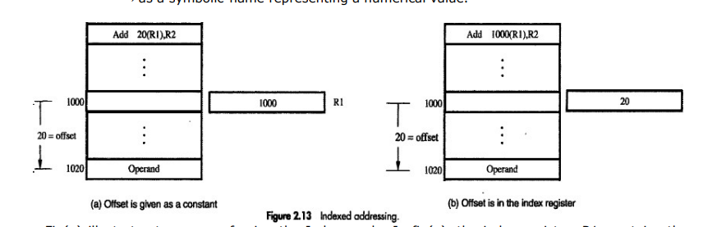
Indexed Addressing mode

Slide 75
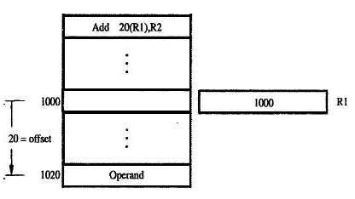
Index register, R1 contains the address of a memory-location
The value X defines an offset(also called a displacement) from this address to the location where the operand is found.
To find EA of operand:
Eg: Add 20(R1), R2
EA = 1000 + 20 = 1020
Fig: Index addressing: Offset is given as a constant

Slide 76
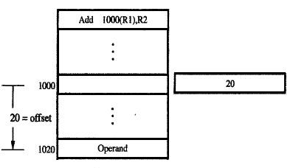
The constant X corresponds to a memory address
The contents of the index register define the offset to the operand
EA = 1000+20=1020
R1
Fig: Index addressing: Offset is in the register

Slide 77
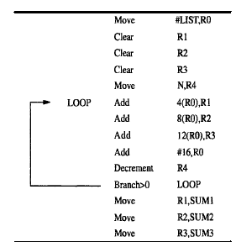
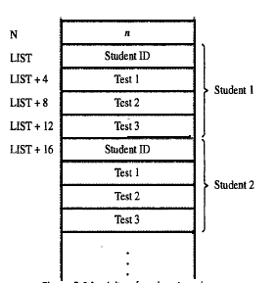
Fig: pgm to compute sum of all scores obtained on each of the tests and store in memory locations SUM1,SUM2 & SUM3. Indexed addressing used in accessing test scores in the list
Fig: A list of student marks

Slide 78
Base with Index Mode
Another version of the Index mode uses 2 registers which can be denoted as
(Ri, Rj)
Here, a second register usually called as base register may be used to contain the offset X.
The effective-address of the operand is given by
EA=[Ri]+[Rj]
This form of indexed addressing provides more flexibility in accessing operands because both components of the effective-address can be changed.
is the sum

Slide 79
Base with Index & Offset Mode
Another version of the Index mode uses 2 registers plus a constant, which can be denoted as
X(Ri, Rj)
The effective-address of the operand is given by
EA=X+[Ri]+[Rj]
This added flexibility is useful in accessing multiple components inside each item in a record, where the beginning of an item is specified by the (Ri, Rj) part of the addressing mode. This mode implements a 3-dimensional array.
Store R5,30(R1,R2)
This means 30+R1+R2 and store the result into R5 . so R5 = 30+1200+4600 = 5830, so now R5 value is 5830, and the effective address is 5830

Slide 80
Relative Mode
Similar to index-mode with one difference:The effective-address is determined using the PC in place of the general purpose register Ri.
The operation is indicated as X(PC).
X(PC) denotes an effective-address of the operand which is X locations above or below the current contents of PC.
Since the addressed-location is identified "relative" to the PC, the name Relative mode is associated with this type of addressing.
This mode is used commonly in conditional branch instructions. An instruction such as
Branch > 0 LOOP ; Causes program execution to go to the branch target location ; identified by name LOOP if branch condition is satisfied.

Slide 81
Additional Modes
Autoincrement mode
Effective-address of operand is contents of a register specified in the instruction
After accessing the operand, the contents of this register are automatically incremented to
point to the next item in a list.
This mode is denoted as
(Ri)+
The increment is 1 for byte sized operands, 2 for 16 bit operands and 4 for 32 bit operands.
Instruction uses (Ri)+ for a 16-bit operand, Ri = 1000
Then: Operand is taken from address 1000
Ri is incremented by 2, so new value of Ri = 1002

Slide 82
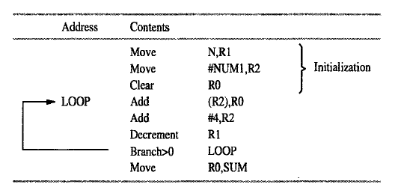
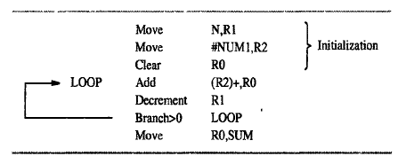
Example: program to add list of n numbers
Using Indirect addressing mode
Using Autoincrement mode

Slide 83
Autodecrement mode
The contents of the register specified in the instruction are first automatically decremented and are then used as the effective address of the operand.
We write the autodecremented mode as-
– (Ri)
In this mode operands are accessed in decreasing address order.
Instruction uses -(Ri) for a 16-bit operand, Ri = 1008
Then: Operand is taken from address 1008
Ri is incremented by 2, so new value of Ri = 1006

Slide 84
Exercise Examples
Registers R1 and R2 of a computer contain the decimal values 1200 and 4600.What is the Effective address of the memory operand in each of the following instructions?
a) Load 20(R1),R5
b) Move #3000,R5
c) Store R5,30(R1,R2)
d) Add -(R2),R5
e) Subtract (R1)+,R5

Slide 85
Load 20(R1),R5 : This means load 20+R1 into R5 . R1= 1200 , R1 + 20 = 1220 , so R5 have 1220 , Effective address of R5 is 1220
Move #3000,R5: This means move value 3000 into R5, so the effective address is part of the instruction whose value is 3000.
Store R5,30(R1,R2) : This means 30+R1+R2 and store the result into R5 . so R5 = 30+1200+4600 = 5830, so now R5 value is 5830, and the effective address is 5830.
Add -(R2),R5 : This means -1 from the R2 value and stores the result into R5. So R5= 4600 - 1 = 4599 , and the effective address of R5 is 4599. It is pre-decrement addressing.
Subtract (R1)+,R5 : This means the effective address is contents of R1 so EA = 1200 .
It is post-increment addressing.

